Slide 1
BINOMIAL EXPANSION(2)
(BINOMIAL EXPANSION (2))
DR ILOJIDE E.

Slide 2
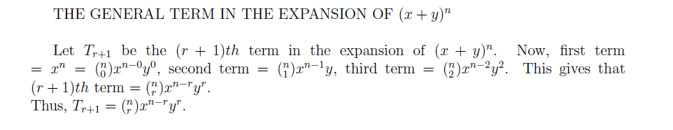
GENERAL TERM

Slide 3
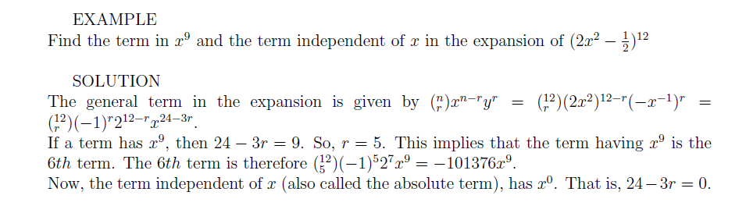
EXAMPLE

Slide 4
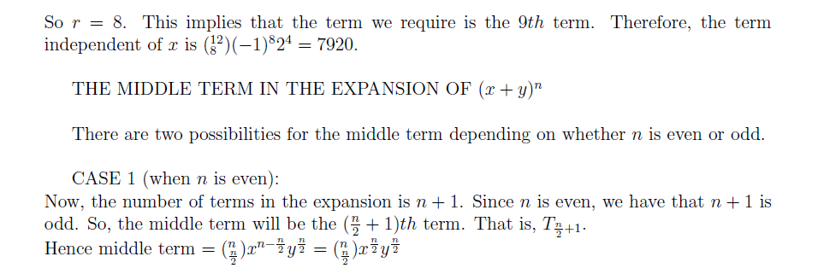
MIDDLE TERM

Slide 5
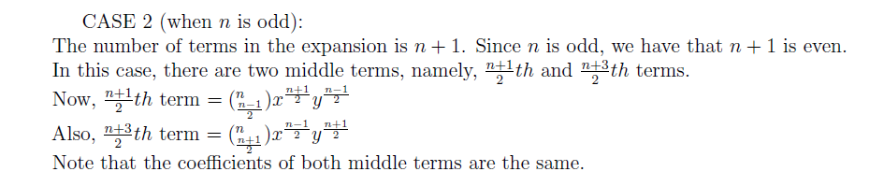
Middle Term continues

Slide 6
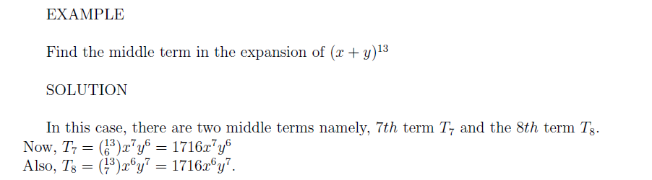
EXAMPLE

Slide 7
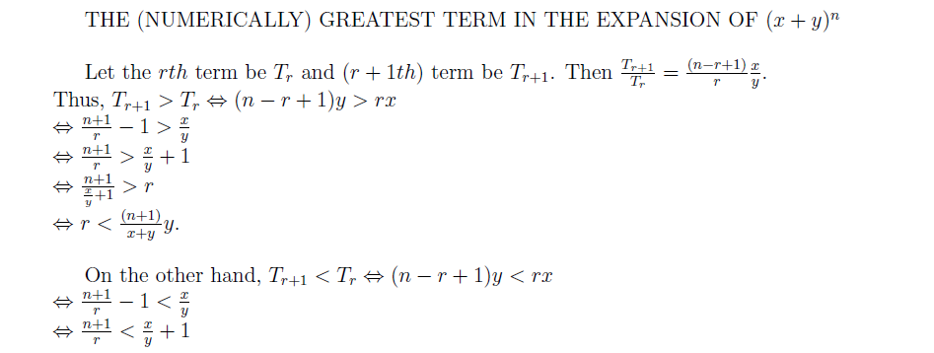
GREATEST TERM

Slide 8
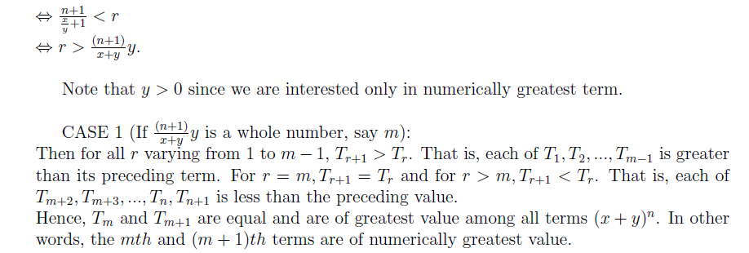
Greatest Term continues

Slide 9
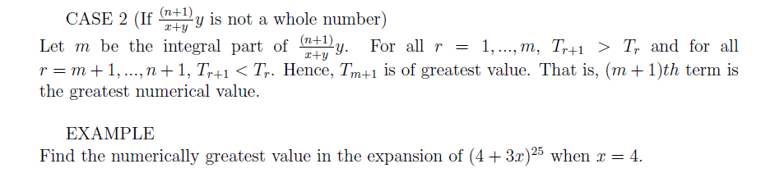
EXAMPLE

Slide 10
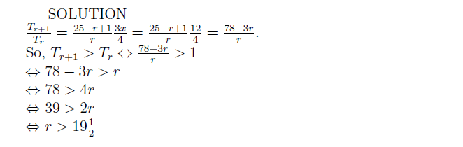
SOLUTION

Slide 11
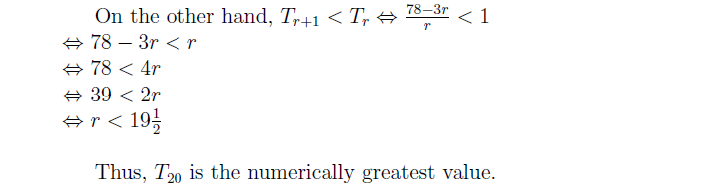
Solution continues

Slide 12
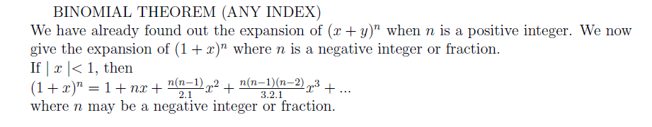
Binomial Theorem (Any index)

Slide 13
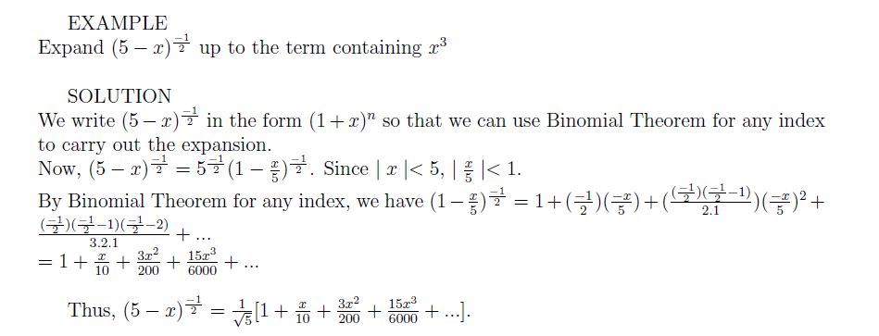
Example

Slide 14
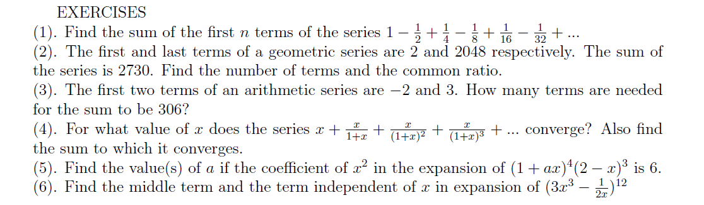
EXERCISES

